Slide 1
Cookies

Slide 2

Agenda
Stateless nature of HTTP Protocol
Explain the need for Session
Understanding the benefits and drawback of cookies
Sending Outgoing cookies
Receiving Incoming cookies
Tracking repeat visitors
Specifying cookie attributes

Slide 3
HTTP Protocol
Stateless Protocol
Communication protocol is stateless
Communication consist of independent pairs of request and response
IP and HTTP are stateless protocols
Advantages of stateless protocol
No need to dynamically allocate storage for conversation
No clean up activity if request dies mid way

Slide 4
HTTP Protocol
Cookie is a small text file which get stored on the client side
Cookie contains name and value pair
Cookie is stored only for a particular duration after which they are expired
Client returns the same name and value when it connects to the
Same site
Same domains
Depends upon cookie setting

Slide 5
HTTP Protocol
Typical Uses of Cookies
Identifying a user during an e-commerce session
Servlets have a higher-level API for this task
Avoiding username and password
Customizing a site
Focusing advertising

Slide 6
Problems with Cookies
The problem is privacy, not security.
Servers can remember your previous actions
If you give out personal information, servers can link that information to your previous actions
Servers can share cookie information through use of a cooperating third party like doubleclick.net
Poorly designed sites store sensitive information like credit card numbers directly in cookie
JavaScript bugs let hostile sites steal cookies (old browsers)

Slide 7
Problems with Cookies
The problem is privacy, not security.
Moral for servlet authors
If cookies are not critical to your task, avoid servlets that totally fail when cookies are disabled
Don't put sensitive info in cookies

Slide 8
Sending a simple Cookie
import java.io.IOException;
import java.io.PrintWriter;
import javax.servlet.http.Cookie;
import javax.servlet.http.HttpServlet;
import javax.servlet.http.HttpServletRequest;
import javax.servlet.http.HttpServletResponse;
public class ServletDemo extends HttpServlet{
public void doGet(HttpServletRequest request, HttpServletResponse response) throws IOException{ response.setContentType("text/html");
PrintWriter pw = response.getWriter();
Cookie cookie = new Cookie(“name",”talentedge”);
cookie.setMaxAge(60*60); //1 hour
response.addCookie(cookie);
pw.println("Cookies created");
} }

Slide 9
Reading Cookies
public static String getCookieValue(Cookie[] cookies, String cookieName, String defaultValue)
{
for(int i=0; i<cookies.length; i++)
{
Cookie cookie = cookies[i];
if (cookieName.equals(cookie.getName()))
return(cookie.getValue());
}
return(defaultValue);
}

Slide 10
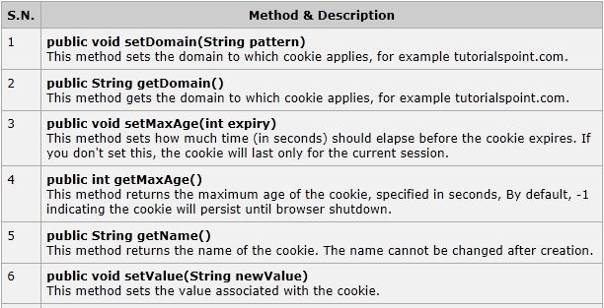
Cookie Method

Slide 11
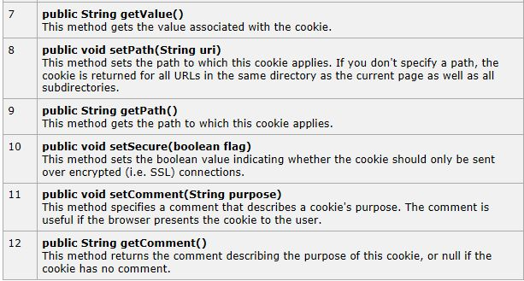
Cookie Method

Slide 12
Summary
Creates a cookie, a small amount of information sent by a servlet to a Web browser, saved by the browser, and later sent back to the server. A cookie's value can uniquely identify a client, so cookies are commonly used for session management.
A cookie has a name, a single value, and optional attributes such as a comment, path and domain qualifiers, a maximum age, and a version number. Some Web browsers have bugs in how they handle the optional attributes, so use them sparingly to improve the interoperability of your servlets.

Slide 13

Summary
The servlet sends cookies to the browser by using the HttpServletResponse.addCookie(javax.servlet.http.Cookie) method, which adds fields to HTTP response headers to send cookies to the browser, one at a time. The browser is expected to support 20 cookies for each Web server, 300 cookies total, and may limit cookie size to 4 KB each.
The browser returns cookies to the servlet by adding fields to HTTP request headers. Cookies can be retrieved from a request by using the HttpServletRequest.getCookies() method. Several cookies might have the same name but different path attributes.

